Slide 1




A Bayesian Approach To Filtering Junk E-Mail
Mehran Sahami, Susan Dumais, David Heckerman, Eric Horvitz
Sailal Goparaju, Vamsi Yalamanchili

Slide 2
OUTLINE
Abstract
Introduction
Probabilistic Classification
Domain Specific Characteristics
Results
Real Usage Scenario
Conclusion

Slide 3
Abstract
In addressing the growing problem of junk E-mail on the Internet, we examine methods for the automated construction of filters to eliminate such unwanted messages from a user’s mail stream.
By casting this problem in a decision theoretic framework, we are able to make use of probabilistic learning methods in conjunction with a notion of differential misclassification cost to produce filters which are especially appropriate for this task.
While this may appear, at first, to be a straight-forward text classification problem, we can produce much more accurate filters.
Finally, we show the efficacy of such filters in a real world usage scenario, arguing that this technology is mature enough for deployment

Slide 4
Introduction
E-mail is the extremely cheap and easy to send, it has gained enormous popularity.
Unfortunately, the same virtues that have made E-mail popular among direct marketers to bombard unsuspecting E-mailboxes with unsolicited messages regarding everything from items for sale and get-rich-quick schemes etc.
With the proliferation of direct marketers and the increased availability of enormous Email address mailing lists , the volume of junk mail has grown tremendously in the past few years.
Lastly, junk mail not only wastes user time, but can also quickly fill-up file server storage space.
Notes:
When conducting research, it is easy to go to one source: Wikipedia. However, you need to include a variety of sources in your research. Consider the following sources:
Who can I interview to get more information on the topic?
Is the topic current and will it be relevant to my audience?
What articles, blogs, and magazines may have something related to my topic?
Is there a YouTube video on the topic? If so, what is it about?
What images can I find related to the topic?

Slide 5
Introduction
As a result of this growing problem, automated methods for filtering such junk from legitimate E-mail are becoming necessary.
Many commercial products are now available which allow users to handcraft a set of logical rules to filter junk mail. This is a time-consuming and often tedious process which can be notoriously error-prone.
Past Research has looked specifically at particular features that are indicative of "flames", which in general are quite different than those used for junk mail filtering.
By making use of the extensible framework of Bayesian modeling, we can not only employ traditional document classification techniques based on the text of messages, but we can also easily incorporate domain knowledge about the particular task at hand through the introduction of additional features in our Bayesian classifier.
Notes:
When conducting research, it is easy to go to one source: Wikipedia. However, you need to include a variety of sources in your research. Consider the following sources:
Who can I interview to get more information on the topic?
Is the topic current and will it be relevant to my audience?
What articles, blogs, and magazines may have something related to my topic?
Is there a YouTube video on the topic? If so, what is it about?
What images can I find related to the topic?

Slide 6

Probabilistic Classification
A Bayesian network is a directed, acyclic graph that compactly represents a probability distribution.
In such a graph, each random variable Xi is denoted by a node. A directed edge between two nodes indicates a probabilistic influence (dependency) from the variable denoted by the parent node to that of the child.
Consequently, the structure of the network denotes the assumption that each node Xi in the network is conditionally independent of its non-descendants given its parents.
A Bayesian classifier is simply a Bayesian network applied to a classification task. It contains a node C representing the class variable and a node Xi for each of the features.
Notes:
Once you find your sources, you will want to evaluate your sources using the following questions:
Author:
Who is the author?
Why should I believe what he or she has to say on the topic?
Is the author seen as an expert on the topic? How do you know?
Current:
How current is the information in the source?
When was the source published?
Is the information out-of-date?
Accuracy:
Is the content accurate?
Is the information presented objectively? Do they share the pros and cons?

Slide 7

Probabilistic Classification
The critical quantity in Equation 1 is P(X = x| C= ck), which is often impractical to compute without imposing independence assumptions.
Notes:
Once you find your sources, you will want to evaluate your sources using the following questions:
Author:
Who is the author?
Why should I believe what he or she has to say on the topic?
Is the author seen as an expert on the topic? How do you know?
Current:
How current is the information in the source?
When was the source published?
Is the information out-of-date?
Accuracy:
Is the content accurate?
Is the information presented objectively? Do they share the pros and cons?

Slide 8

Probabilistic Classification
The oldest and most restrictive form of such assumptions is embodied in the Naive Bayesian classifier which assumes that each feature Xi is conditionally independent of every other feature, given the class variable C.
Notes:
Once you find your sources, you will want to evaluate your sources using the following questions:
Author:
Who is the author?
Why should I believe what he or she has to say on the topic?
Is the author seen as an expert on the topic? How do you know?
Current:
How current is the information in the source?
When was the source published?
Is the information out-of-date?
Accuracy:
Is the content accurate?
Is the information presented objectively? Do they share the pros and cons?

Slide 9
Probabilistic Classification
In the context of text classification, specifically junk E-mail filtering, it becomes necessary to represent mail messages as feature vectors so as to make such Bayesian classification methods directly applicable.
To this end, we use the Vector Space model in which we define each dimension of this space as corresponding to a given word in the entire corpus of messages seen.
Each individual message can then be represented as a binary vector denoting which words are present and absent in the message.
With this representation, it becomes straight-forward to learn a probabilistic classifier to detect junk mail given a pre-classified set of training messages
Notes:
Once you find your sources, you will want to evaluate your sources using the following questions:
Author:
Who is the author?
Why should I believe what he or she has to say on the topic?
Is the author seen as an expert on the topic? How do you know?
Current:
How current is the information in the source?
When was the source published?
Is the information out-of-date?
Accuracy:
Is the content accurate?
Is the information presented objectively? Do they share the pros and cons?

Slide 10
Domain Specific Properties
It is important to note that there are many particular features of E-mail beside just the individual words in the text of a message that provide evidence as to whether a message is junk or not. For example "FREE!”.
It is straight-forward to incorporate such additional problem-specific features for junk mail classification into the Bayesian classifiers by simply adding additional variables denoting the presence or absence of these features into the vector for each message.
Hence, the learning algorithms employed need not be modified
Notes:
After consulting a variety of sources, you will need to narrow your topic. For example, the topic of internet safety is huge, but you could narrow that topic to include internet safety in regards to social media apps that teenagers are using heavily. A topic like that is more specific and will be relevant to your peers. Some questions to think about to help you narrow your topic:
What topics of the research interest me the most?
What topics of the research will interest my audience the most?
What topics will the audience find more engaging? Shocking? Inspiring?

Slide 11
For example, particular phrases, such as "Free Money", or over-emphasized punctuation, such as "!!!!", are of junk E-mail.
Approximately 35 such hand-crafted phrases that seemed particularly germane to this problem were included.
In addition to phrasal features, domain-specific non-textual features are also considered, such as the domain type of the sender.
Such as the domain type of the message sender (e.g., .edu or .com), which provide great deal of information as to whether a message is junk or not. Junk mail is virtually never sent from . edu domains

Slide 12
Many programs for reading Email will resolve familiar E-mail address (i.e. replace sdumais©Microsoft.com , with Susan Dumais). By detecting such resolutions, which often happen with messages sent by users familiar to the recipient, we can also provide additional evidence that a message is not junk.
Another good evidence is that if a message is junk or not is found in examining if the recipient of a message was the individual user or if the message was sent via a mailing list.
A message has attached documents (most junk E-mail does not have them), or when a given message was received (most junk E-mail is sent at night).

Slide 13
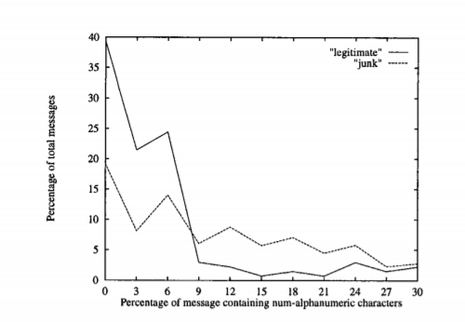
Domain Specific Properties
In total, we included approximately 20 non-phrasal hand-crafted, domain-specific features into the junk Email filter.
"$$$$ BIG MONEY $$$$"
Notes:
After consulting a variety of sources, you will need to narrow your topic. For example, the topic of internet safety is huge, but you could narrow that topic to include internet safety in regards to social media apps that teenagers are using heavily. A topic like that is more specific and will be relevant to your peers. Some questions to think about to help you narrow your topic:
What topics of the research interest me the most?
What topics of the research will interest my audience the most?
What topics will the audience find more engaging? Shocking? Inspiring?

Slide 14
Results
A number of experiments are conducted for junk E-mail detection.
Both the performance of various enhancements to the simple baseline classification based on the raw text of the messages, as well as looking at the efficacy of learning such a junk filter in an operational setting are measured.
Feature selection is employed for several reasons. First, such dimensionality reduction helps provide an explicit control on the model variance resulting from estimating many parameters.
Moreover, feature selection also helps to attenuate the degree to which the independence assumption is violated by the Naive Bayesian classifier.
Notes:
Now, that you have narrowed your topic, you will want to organize your research in a structure that works. There are some common organizational patterns based on the kind of research you are doing.
Organizational Structures:
Cause and Effect- this kind of structure is great for explaining the causes and effects of a topic
Compare and Contrast- in this pattern you highlight the similarities and differences of the topic
Explain process- this structure is great for outlining a series of steps to follow;
Definition- if you want to make sure your audience understands what something is using illustrations, meanings, clarifying misconceptions, you may want to use this structure
Classification- a common organizational structure is grouping like topics or facts from the research together. For instance, in the internet safety about social media apps, you may organize the research where you look at each social media app one at a time

Slide 15
Results
We first employ a Zipf’s Law-based analysis of the corpus of E-mail messages to eliminate words that appear fewer than three times as having little resolving power between messages.
500 features for which this value is greatest as the feature set from which to build a classifier are selected.
The initial feature set that is selected include both word-based as well as hand-crafted phrasal and other domain-specific features.
Notes:
Now, that you have narrowed your topic, you will want to organize your research in a structure that works. There are some common organizational patterns based on the kind of research you are doing.
Organizational Structures:
Cause and Effect- this kind of structure is great for explaining the causes and effects of a topic
Compare and Contrast- in this pattern you highlight the similarities and differences of the topic
Explain process- this structure is great for outlining a series of steps to follow;
Definition- if you want to make sure your audience understands what something is using illustrations, meanings, clarifying misconceptions, you may want to use this structure
Classification- a common organizational structure is grouping like topics or facts from the research together. For instance, in the internet safety about social media apps, you may organize the research where you look at each social media app one at a time

Slide 16
Results
USING DOMAIN-SPECIFIC FEATURES
Here, a corpus of 1789 actual E-mail messages of which 1578 messages are pre-classified as "junk" and 211 messages are pre-classified as "legitimate."
Note that the proportion of junk to legitimate mail in this corpus makes it more likely that legitimate mail will be classified as junk. Since such an error is far worse than marking a piece of junk mail as being legitimate, as this class disparity creates a more challenging classification problem.
The data is then split temporally into a training set of 1538 messages and a testing set of 251 messages.
Notes:
Now, that you have narrowed your topic, you will want to organize your research in a structure that works. There are some common organizational patterns based on the kind of research you are doing.
Organizational Structures:
Cause and Effect- this kind of structure is great for explaining the causes and effects of a topic
Compare and Contrast- in this pattern you highlight the similarities and differences of the topic
Explain process- this structure is great for outlining a series of steps to follow;
Definition- if you want to make sure your audience understands what something is using illustrations, meanings, clarifying misconceptions, you may want to use this structure
Classification- a common organizational structure is grouping like topics or facts from the research together. For instance, in the internet safety about social media apps, you may organize the research where you look at each social media app one at a time

Slide 17
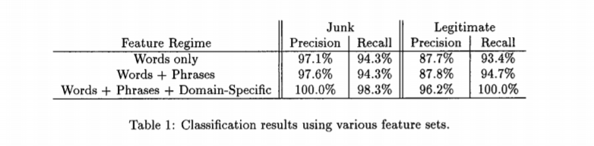
Results
Junk precision is the percentage of messages in the test data classified as junk which truly are. Legitimate precision denotes the percentage of messages in the test data classified as legitimate which truly are.
Junk recall denotes the proportion of actual junk messages in the test set that are categorized as junk by the classifier, and legitimate recall denotes the proportion of actual legitimate messages in the test set that are categorized as legitimate.
Notes:
Now, that you have narrowed your topic, you will want to organize your research in a structure that works. There are some common organizational patterns based on the kind of research you are doing.
Organizational Structures:
Cause and Effect- this kind of structure is great for explaining the causes and effects of a topic
Compare and Contrast- in this pattern you highlight the similarities and differences of the topic
Explain process- this structure is great for outlining a series of steps to follow;
Definition- if you want to make sure your audience understands what something is using illustrations, meanings, clarifying misconceptions, you may want to use this structure
Classification- a common organizational structure is grouping like topics or facts from the research together. For instance, in the internet safety about social media apps, you may organize the research where you look at each social media app one at a time

Slide 18
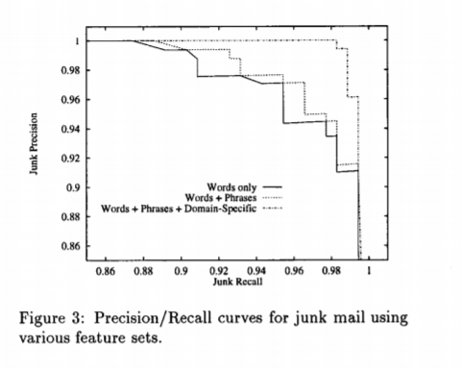
Results
Notes:
Now, that you have narrowed your topic, you will want to organize your research in a structure that works. There are some common organizational patterns based on the kind of research you are doing.
Organizational Structures:
Cause and Effect- this kind of structure is great for explaining the causes and effects of a topic
Compare and Contrast- in this pattern you highlight the similarities and differences of the topic
Explain process- this structure is great for outlining a series of steps to follow;
Definition- if you want to make sure your audience understands what something is using illustrations, meanings, clarifying misconceptions, you may want to use this structure
Classification- a common organizational structure is grouping like topics or facts from the research together. For instance, in the internet safety about social media apps, you may organize the research where you look at each social media app one at a time

Slide 19
Results
SUB-CLASSES OF JUNK E-MAIL
In considering the types of E-mail commonly considered junk, there seem to be two dominant groupings. The first is messages related to pornographic Web sites. The second concerns mostly "get-rich-quick" money making opportunities.
Since these two groups are somewhat disparate, the possibility of creating a junk E-mail filter by casting the junk filtering problem as a three category learning task is considered. Here, the three categories of E-mail are defined as legitimate, pornographic-junk, and other-junk.
It is realized that this gives an advantage in terms of evaluation to the three-category task over the two-category task, since, in the three category task, misclassifications between the two subcategories of junk mail (i.e., pornographic-junk messages being classified as other-junk or vice versa) are not penalized.
Notes:
Now, that you have narrowed your topic, you will want to organize your research in a structure that works. There are some common organizational patterns based on the kind of research you are doing.
Organizational Structures:
Cause and Effect- this kind of structure is great for explaining the causes and effects of a topic
Compare and Contrast- in this pattern you highlight the similarities and differences of the topic
Explain process- this structure is great for outlining a series of steps to follow;
Definition- if you want to make sure your audience understands what something is using illustrations, meanings, clarifying misconceptions, you may want to use this structure
Classification- a common organizational structure is grouping like topics or facts from the research together. For instance, in the internet safety about social media apps, you may organize the research where you look at each social media app one at a time

Slide 20
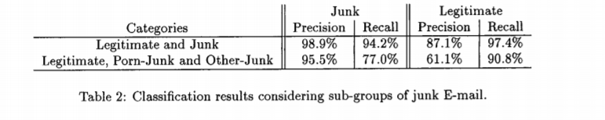
Results
For this experiment, a collection of 1183 E-mail messages of which 972 are junk and 211 are legitimate is considered. This collection is split into a training set of 916 messages and a testing set of 267 messages.
Notes:
Now, that you have narrowed your topic, you will want to organize your research in a structure that works. There are some common organizational patterns based on the kind of research you are doing.
Organizational Structures:
Cause and Effect- this kind of structure is great for explaining the causes and effects of a topic
Compare and Contrast- in this pattern you highlight the similarities and differences of the topic
Explain process- this structure is great for outlining a series of steps to follow;
Definition- if you want to make sure your audience understands what something is using illustrations, meanings, clarifying misconceptions, you may want to use this structure
Classification- a common organizational structure is grouping like topics or facts from the research together. For instance, in the internet safety about social media apps, you may organize the research where you look at each social media app one at a time

Slide 21
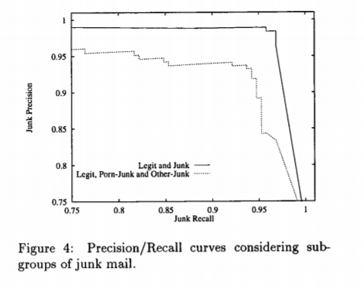
Results
Notes:
Now, that you have narrowed your topic, you will want to organize your research in a structure that works. There are some common organizational patterns based on the kind of research you are doing.
Organizational Structures:
Cause and Effect- this kind of structure is great for explaining the causes and effects of a topic
Compare and Contrast- in this pattern you highlight the similarities and differences of the topic
Explain process- this structure is great for outlining a series of steps to follow;
Definition- if you want to make sure your audience understands what something is using illustrations, meanings, clarifying misconceptions, you may want to use this structure
Classification- a common organizational structure is grouping like topics or facts from the research together. For instance, in the internet safety about social media apps, you may organize the research where you look at each social media app one at a time

Slide 22
The first is that while some features may be very clearly indicative of junk versus legitimate E-mail in the two-category task, these features may not be as powerful (i.e., probabilistically skewed) in the three-category task since they do not distinguish well between the sub-classes of junk.
The second reason is that the increase in classification variance that accompanies a model with more degrees of freedom.
As the classifier in the three-category task must fit many more parameters from the data than the classifier in the two-category task, the variance in the estimated parameters leads to an overall decrease in the performance of the former classifier.

Slide 23
Real Usage Scenario
A junk mail filter must also be able to accurately discern true junk from mail which a user would want to read once and then discard, as the latter should be considered legitimate mail even though it is not permanently stored.
A user’s real mail repository of 2593 messages which have been classified as either junk or legitimate as the training set for our filter. As the testing data, all 222 messages that are sent to this user during the week following the period from which the training data was collected.
To show the growing magnitude of the junk E-mail problem, these 222 messages contained 45 messages (over 20% of the incoming mail) which were later deemed to be junk by the user.
Notes:
After you’ve done your research, it’s time to put your presentation together. The first step in the process is to introduce the topic. This is a great time to connect your topic to something that your audience can relate. In other words, why should they listen to all the information you will be sharing in your research presentation? What is in it for them? You may also want to include a graphic or image to grab their attention.
Feel free to duplicate this slide by right-clicking on this slide in the slides pane to the left and select Duplicate Slide.
The next step in your presentation is to state your claim or topic clearly. Your teacher may even call this your thesis. As you state your thesis, you may find that this layout is not the best layout for your claim or topic. You can change the layout by clicking the drop-down menu next to the Layout in the Slides menu section. You can choose Two Content, Comparison, or Picture with Caption. Note: A different layout might change the look of the icons on this page.
You will also want to state your facts. You have done the research now share some of the interesting facts with your audience. Facts do not have to be boring; you can communicate facts in a variety of ways by going to the Insert Tab. In the Insert tab you can:
Insert pictures from your computer or online.
Add a chart
Create some SmartArt
Insert a variety of icons to help your facts come to life. Note: You can change the color of the icons by selecting the icon and then click on the Format tab and then Graphics Fill. From there, you will choose a color from the list or choose More Fill Colors to give you more options.
Since this research presentation is a result of your hard work and searching, you want to make sure you support the claims or points in your presentation with facts from your research findings. Make sure you give the author proper credit for helping you share your ideas. If one of your sources has a video that is relevant to your topic, you can add the video as added support. Keep in mind the length of the video and the amount of time you have for your presentation. For a 5 minute speech, the video should be no longer than 30 seconds.
Questions to consider:
How will you state the author of the source?
Will you need to cite the source on the slide?
What are some ways you can engage your audience so they feel like they are a part of the presentation? Some ideas to consider is by taking a quick poll like: by a show of hands, how many of you think school uniforms are a way to cut down on bullying? Another suggestion is to have them hold up a certain number of fingers to see if they agree or disagree. Finally, you can share a story that the audience can relate to that makes them laugh.
After all the applause, your audience may have some questions. Be prepared to answer some of their questions by making a list of questions you think they might ask. You may also want to share the presentation with them by providing the link to your presentation, if they want more information.

Slide 24
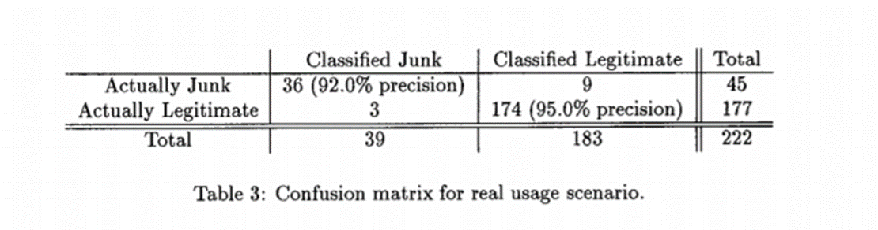
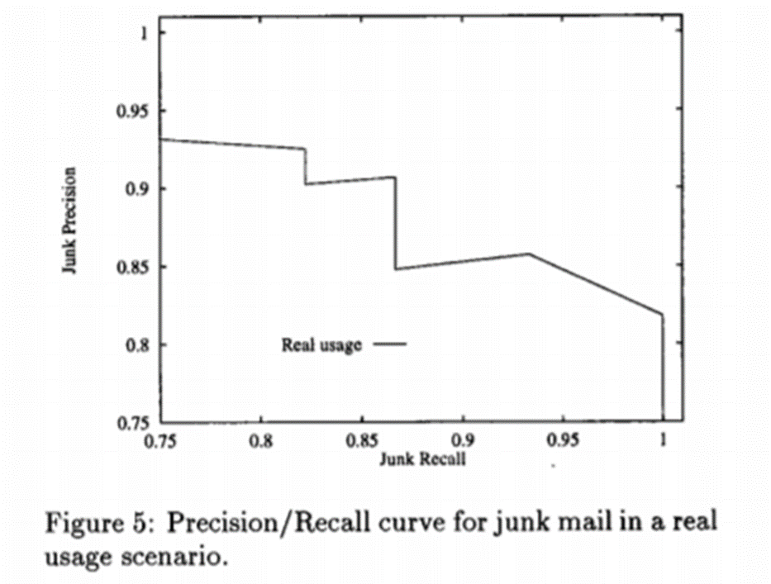

Slide 25
Of the three legitimate messages classified as junk by the filter, one is a message which is actually a junk mail message forwarded to the user in our study. This message begins with the sentence "Check out this spam..." and then contains the full text of a junk E-mail message.
The other two misclassified legitimate messages are simply news stories from a E-mail news service that the user subscribes to. These messages happen to be talking about "hype" in the Web search engine industry and are not very important to the user.
It can be seen that the filter is in fact quite successful at eliminating 80% of the incoming junk E-mail from the user’s mail stream.

Slide 26
Conclusion
In examining the growing problem of dealing with junk E-mail, it is found that it’s possible to automatically learn effective filters to eliminate a large portion of such junk from a user’s mail stream.
The efficacy of such filters can also be greatly enhanced by considering not only the full text of the E-mail messages to be filtered, but also a set of hand-crafted features which are specific for the task at hand.
The improvement seen from the use of domain-specific features for this particular problem provides strong evidence for the incorporation of more domain knowledge in other text categorization problems.
Moreover, by using an extensible classification formalism such as Bayesian networks, it becomes possible to easily and uniformly integrate such domain knowledge into the learning task.
Notes:
After you’ve done your research, it’s time to put your presentation together. The first step in the process is to introduce the topic. This is a great time to connect your topic to something that your audience can relate. In other words, why should they listen to all the information you will be sharing in your research presentation? What is in it for them? You may also want to include a graphic or image to grab their attention.
Feel free to duplicate this slide by right-clicking on this slide in the slides pane to the left and select Duplicate Slide.
The next step in your presentation is to state your claim or topic clearly. Your teacher may even call this your thesis. As you state your thesis, you may find that this layout is not the best layout for your claim or topic. You can change the layout by clicking the drop-down menu next to the Layout in the Slides menu section. You can choose Two Content, Comparison, or Picture with Caption. Note: A different layout might change the look of the icons on this page.
You will also want to state your facts. You have done the research now share some of the interesting facts with your audience. Facts do not have to be boring; you can communicate facts in a variety of ways by going to the Insert Tab. In the Insert tab you can:
Insert pictures from your computer or online.
Add a chart
Create some SmartArt
Insert a variety of icons to help your facts come to life. Note: You can change the color of the icons by selecting the icon and then click on the Format tab and then Graphics Fill. From there, you will choose a color from the list or choose More Fill Colors to give you more options.
Since this research presentation is a result of your hard work and searching, you want to make sure you support the claims or points in your presentation with facts from your research findings. Make sure you give the author proper credit for helping you share your ideas. If one of your sources has a video that is relevant to your topic, you can add the video as added support. Keep in mind the length of the video and the amount of time you have for your presentation. For a 5 minute speech, the video should be no longer than 30 seconds.
Questions to consider:
How will you state the author of the source?
Will you need to cite the source on the slide?
What are some ways you can engage your audience so they feel like they are a part of the presentation? Some ideas to consider is by taking a quick poll like: by a show of hands, how many of you think school uniforms are a way to cut down on bullying? Another suggestion is to have them hold up a certain number of fingers to see if they agree or disagree. Finally, you can share a story that the audience can relate to that makes them laugh.
After all the applause, your audience may have some questions. Be prepared to answer some of their questions by making a list of questions you think they might ask. You may also want to share the presentation with them by providing the link to your presentation, if they want more information.

Slide 27
THANK YOU
Notes:
You can use this slide as your opening or closing slide. Should you choose to use it as a closing, make sure you review the main points of your presentation. One creative way to do that is by adding animations to the various graphics on a slide. This slide has 4 different graphics, and, when you view the slideshow, you will see that you can click to reveal the next graphic. Similarly, as you review the main topics in your presentation, you may want each point to show up when you are addressing that topic.
Add animation to images and graphics:
Select your image or graphic.
Click on the Animations tab.
Choose from the options. The animation for this slide is “Split”. The drop-down menu in the Animation section gives even more animations you can use.
If you have multiple graphics or images, you will see a number appear next to it that notes the order of the animations.
Note: You will want to choose the animations carefully. You do not want to make your audience dizzy from your presentation.

